Slide 1
DAA MINOR PROJECT
Presented by :
171Fa04445
171FA04453
171FA04456

Slide 2
1.ACITIVITY SELECTION PROBLEM

Slide 3
INTODUCTION to daa:
The activity selection problem is a combinatorial optimization problem concerning the selection of non-conflicting activities to perform within a given time frame, given a set of activities each marked by a start time (si) and finish time (fi).

Slide 4
According to greedy method:
sort the activities as per finishing time in ascending order
select the first activity
select the new activity if its starting time is greater than or equal to the previously selected activity REPEAT step 3 till all activities are checked

Slide 5
Coding:
#include<iostream>
using namespace std;
void printMaxActivities(int s[], int f[], int n)
{
int i, j;
cout<<"Following activities are selected n: ";
i = 0;
cout<<i<<" ";
for (j = 1; j < n; j++)
{
if (s[j] >= f[i])
{

Slide 6
cout<<j<<" ";
i = j;
}
}
}
int main()
{
int s[] = {1, 3, 0, 5, 8, 5};
int f[] = {2, 4, 6, 7, 9, 9};
int n = sizeof(s)/sizeof(s[0]);
printMaxActivities(s, f, n);
return 0;
}

Slide 7
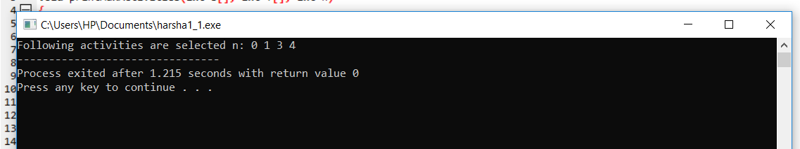
Output:

Slide 8
2.TOPOLOGICAL SORT

Slide 9
INTODUCTION:
In the field of computer science, a topological sort (sometimes abbreviated toposort) or topological ordering of a directed graph is a linear ordering of its vertices such that for every directed edge uv from vertex u to vertex v, u comes before v in the ordering.

Slide 10
INTODUCTION TO DAA:
Using an adjacency matrix, displays the times at which the different times at which nodes are visited and left thereby producing a linear ordering of vertices in a graph. A graph is a set of nodes connected by edges. Here is the source code of the C++ program to display topological sort.

Slide 11
KHAN’S ALGORTHIM FOR TS:
Topological sorting for Directed Acyclic Graph (DAG) is a linear ordering of vertices such that for every directed edge uv, vertex u comes before v in the ordering. Topological Sorting for a graph is not possible if the graph is not a DAG.

Slide 12
Coding:
#include<iostream>
#include <list>
#include <stack>
using namespace std;
class Graph
{
int V;
list<int> *adj;
void topologicalSortUtil(int v, bool visited[], stack<int> &Stack);
public:
Graph(int V);
void addEdge(int v, int w);
void topologicalSort();
};

Slide 13
Graph::Graph(int V)
{
this->V = V;
adj = new list<int>[V];
}
void Graph::addEdge(int v, int w)
{
adj[v].push_back(w);
}
void Graph::topologicalSortUtil(int v, bool visited[],
stack<int> &Stack)
{
visited[v] = true;
list<int>::iterator i;
for (i = adj[v].begin(); i != adj[v].end(); ++i)
if (!visited[*i])
topologicalSortUtil(*i, visited, Stack);
Stack.push(v);
}

Slide 14
void Graph::topologicalSort()
{
stack<int> Stack;
bool *visited = new bool[V];
for (int i = 0; i < V; i++)
visited[i] = false;
for (int i = 0; i < V; i++)
if (visited[i] == false)
topologicalSortUtil(i, visited, Stack);
while (Stack.empty() == false)
{
cout << Stack.top() << " ";
Stack.pop();
}
}

Slide 15
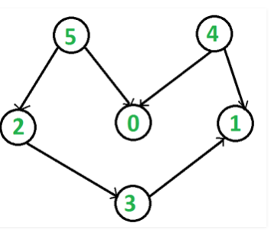
int main()
{
Graph g(6);
g.addEdge(5, 2);
g.addEdge(5, 0);
g.addEdge(4, 0);
g.addEdge(4, 1);
g.addEdge(2, 3);
g.addEdge(3, 1);
cout << "Following is a Topological Sort of the given graph \n";
g.topologicalSort();
return 0;
}
DIAGRAM:

Slide 16
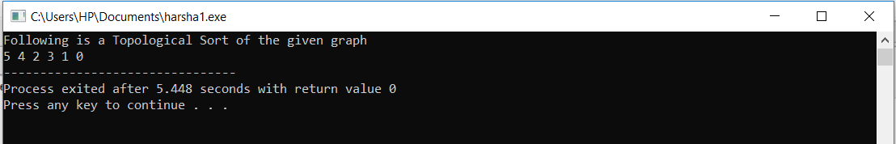
OUTPUT:

Slide 17
THANK YOU

